Slide 1



Projects in R-Studio and Loading Data

Slide 2
Learning Objectives
Create an R project
Look at Data in R
Create data that is appropriate for use with R
Import data
Save and export data

Slide 3



Download today’s data
You can download the R scripts, data, etc:
Moodle
Un-compress the file and save it to your “My Documents” folder
Introduction_to_R project_folder.zip

Slide 4
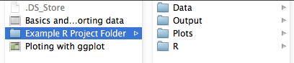
Create an R project
A folder in R-Studio for all your work on one project (eg. Thesis chapter)
Helps you stay organized
R will load from and save to here
Example structure

Slide 5
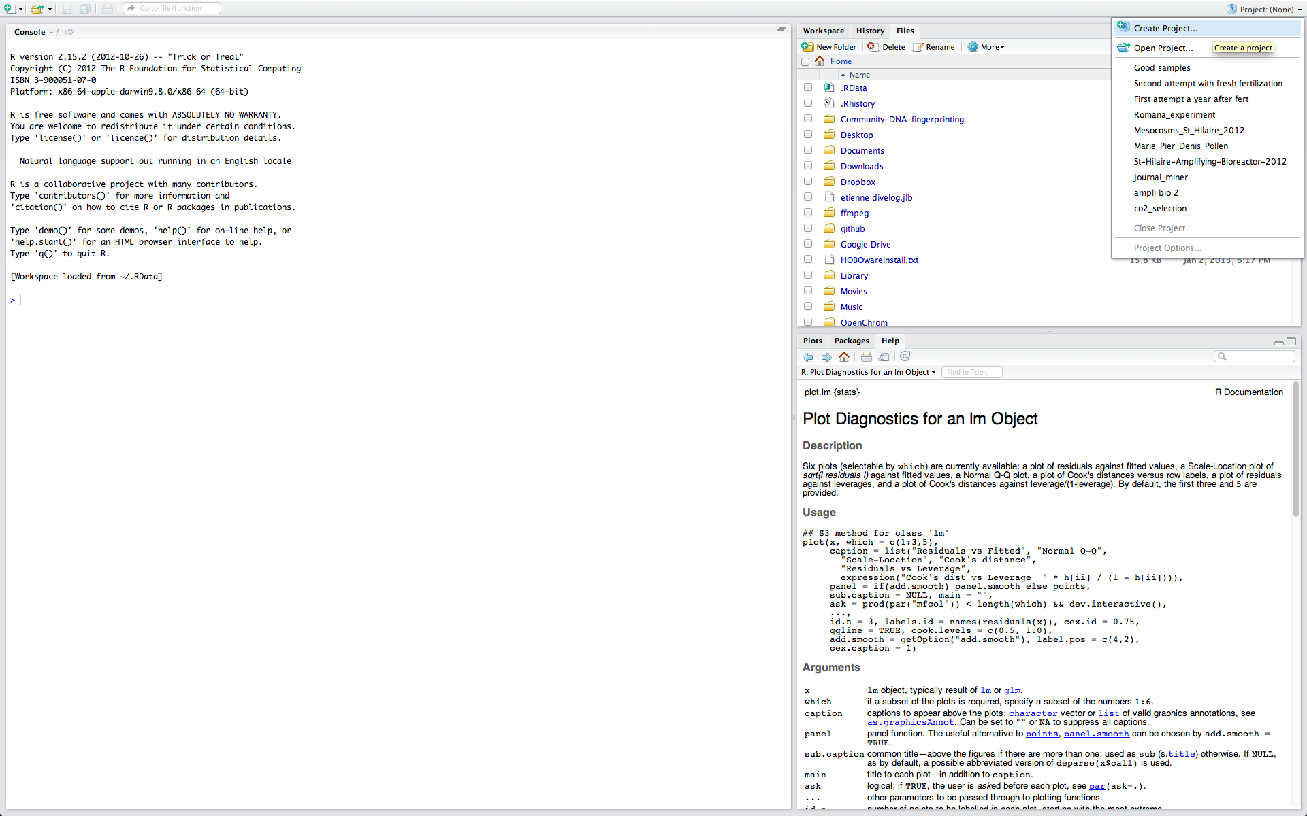
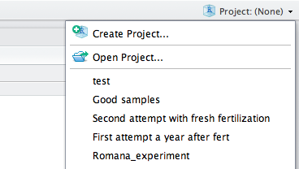
Create an R project in RStudio
In R Studio, select create project from the project menu (top right corner)

Slide 6
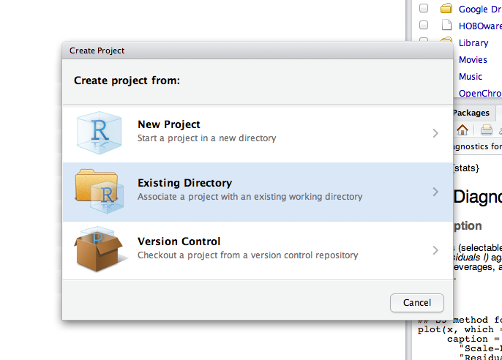
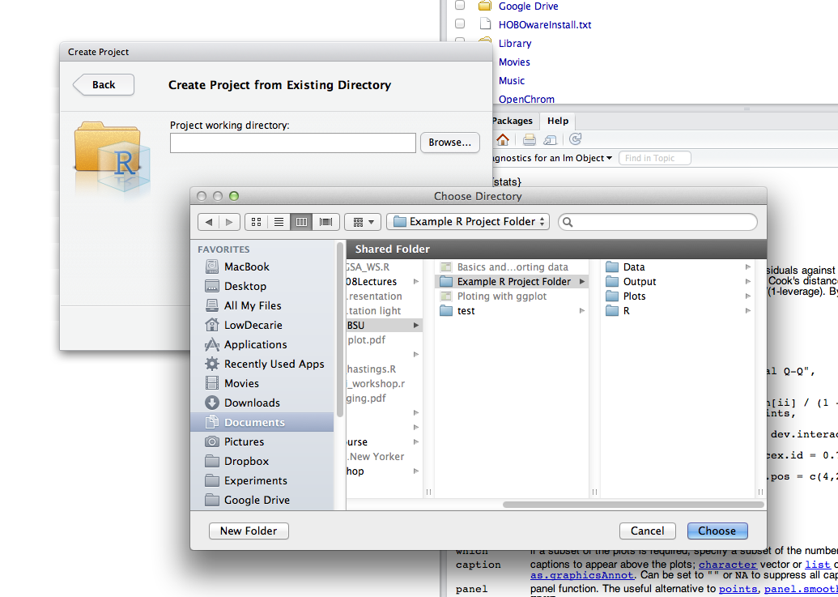
Create an R project
In the existing directory (folder) that you have created or downloaded

Slide 7
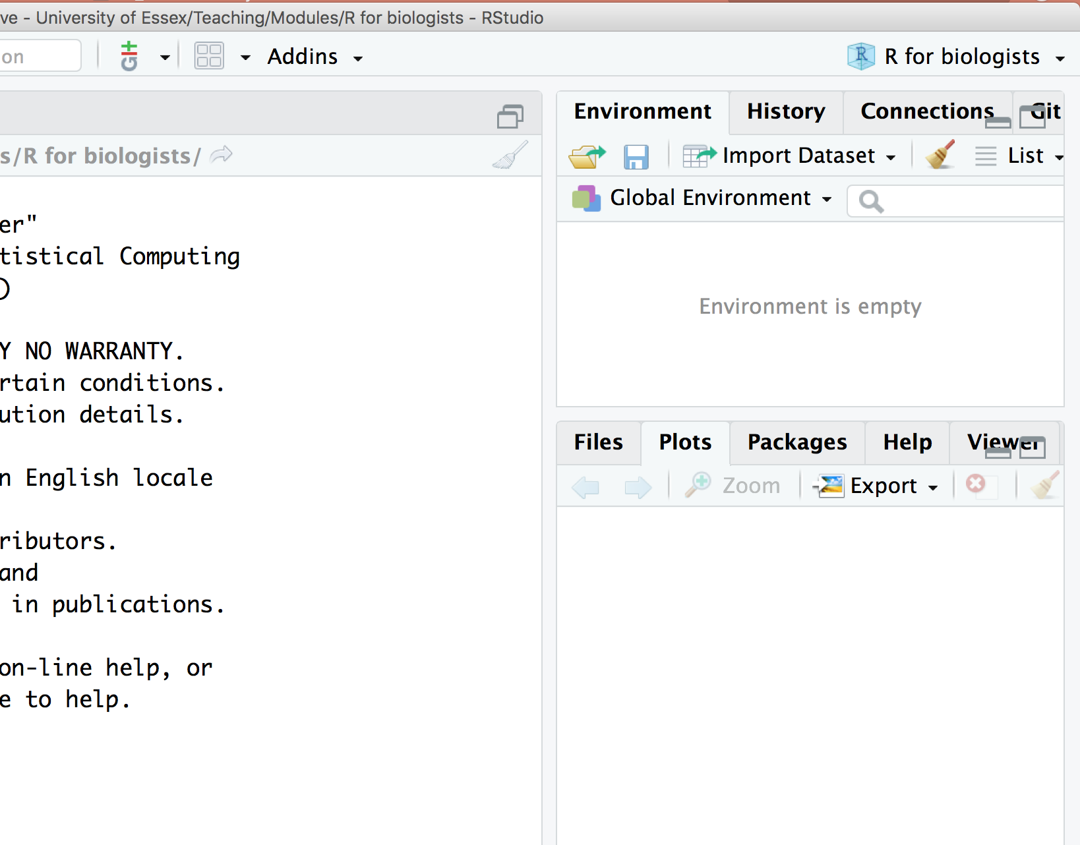
Check current project
getwd()
[1] full path of working directory (eg. …/R for biologists)

Slide 8

The Scripts
What is this?
A text file that contains all the commands you will use
Once written and saved, your script file allows you to make changes and re-run analyses with minimal effort!

Slide 9
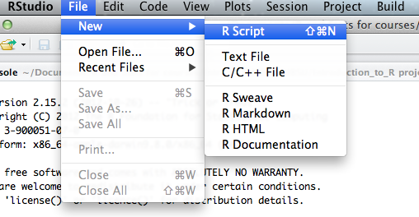
Create an R script

Slide 10
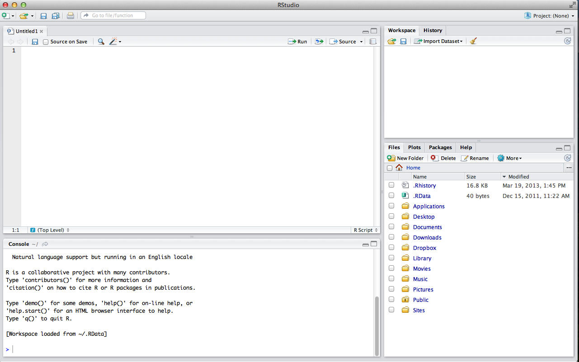
The Script (s)

Slide 11
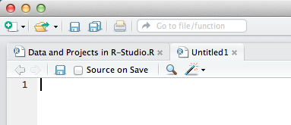
R Projects can have multiple scripts
R script files are in the “R” folder
Recommendation
type code into the blank script that you created
Save them to “my_R_scripts”
refer to provided code only if needed
avoid copy pasting or running the code directly from our script

Slide 12
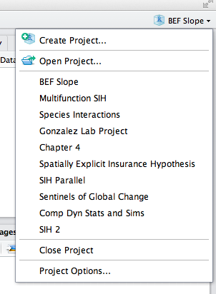
Why use R Projects?
Close and reopen your R Project
In the R – Projects menu
Both our script and the one you created will open automatically
Great way to organize your various projects

Slide 13
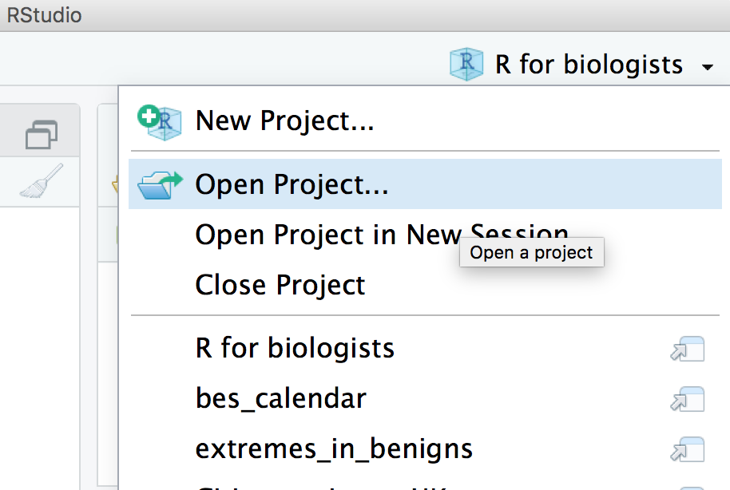
Why use R Projects?
Close and reopen your R Project
In the R – Projects menu
Both our script and the one you created will open automatically
Great way to organize your various projects

Slide 14
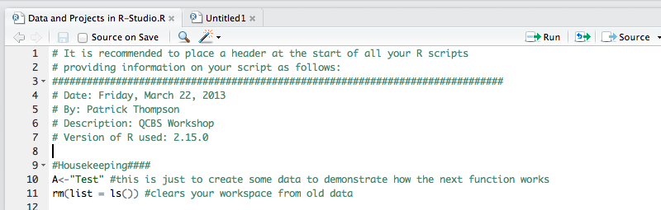
Housekeeping
Steps you should take before running code
Written as a section at the top of scripts

Slide 15
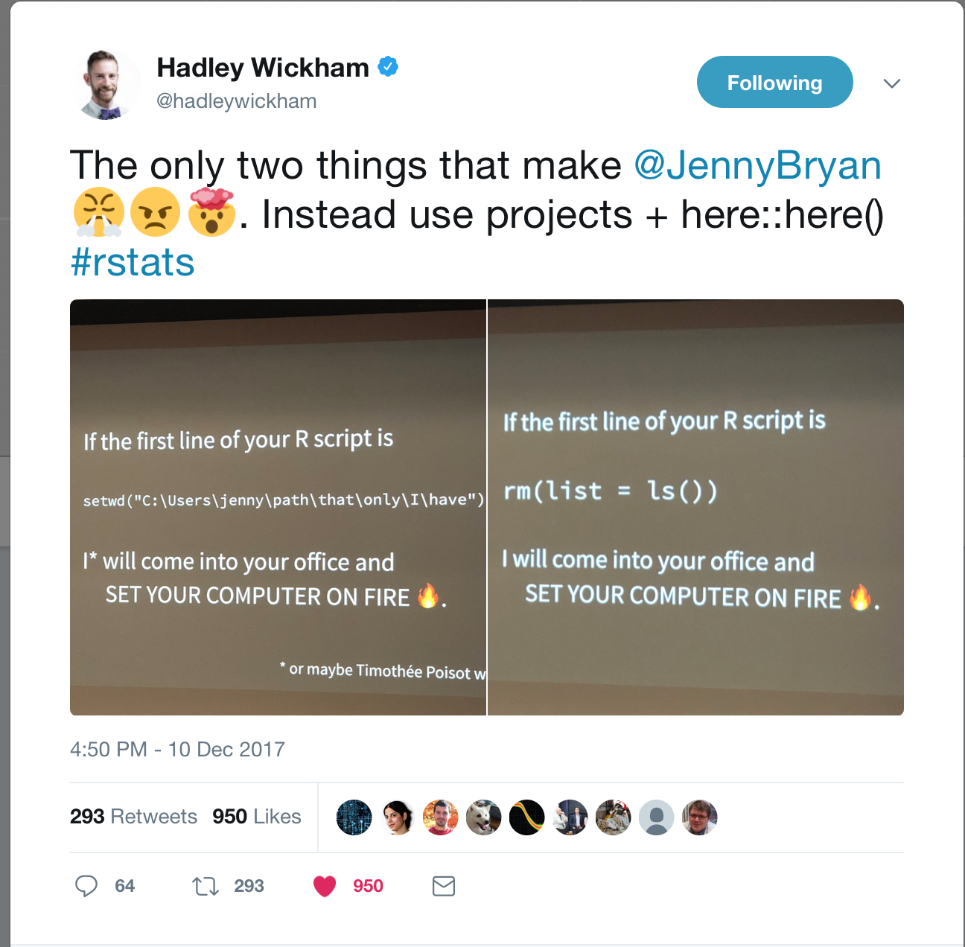
Housekeeping
Explanations: https://www.tidyverse.org/articles/2017/12/workflow-vs-script/

Slide 16
Commenting
# symbol tells R to ignore this
commenting/documenting
annotate someone’s script is good way to learn
remember what you did
tell collaborators what you did
good step towards reproducible science
Supper user hint (shortcut) : ctr (command) + shift + c

Slide 17
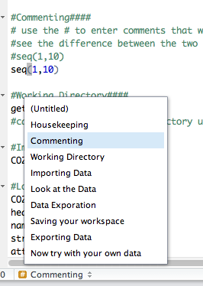
Section Headings
You can make a section heading
#Heading Name####
Allows you to move quickly between sections

Slide 18
Working Directory
Tells R where your scripts and data are
type “getwd()” in the console to see your working directory
RStudio automatically sets the directory to the folder containing your R project
a “/” separates folders and file
You can also set your working directory in the “session” menu

Slide 19
Sub Directories
You can have sub directories within your working directory to organize your data, plots, ect…
“./” – will tell R to start from the current working directory
Eg. We have a folder called “Data” in our working directory
“./Data” – will tell R that you want to access files in that folder

Slide 20
Importing Data
We will now import some data into R
Recall: to find out what arguments the function requires, use help “?”
CO2<-read.csv("./Data/CO2.csv")
New Object in R
Sub Directory
File
?read.csv

Slide 21
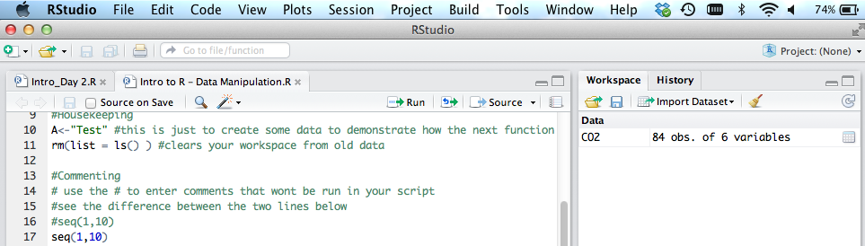
Importing Data
Notice that R-Studio now provides information on the CO2 data
(in Workspace)

Slide 22
Looking at Data
look at the whole dataframe
look at the first few rows
names of the columns in the dataframe
structure of the dataframe
attributes of the dataframe
number of columns
number of rows
summary statistics
plot of all variable combinations
CO2
head(CO2)
names(CO2)
str(CO2)
attributes(CO2)
ncol(CO2)
nrow(CO2)
summary(CO2)
plot(CO2)

Slide 23

Looking at Data
data()
head(), str(), names(), attributes(), summary, plot()
Try again after loading the data with
CO2<- ­read.csv(“CO2.csv”, row.names=1)

Slide 24
Data exploration
Calculate and save the mean of one of your columns
Try with standard deviation (sd) as well
conc_mean<-mean(CO2$conc)
conc_mean
Column
(name)
New Object
(name)
Function
Dataframe
(name)
Run object name to see output

Slide 25
Saving your Workspace
# Saving an R workspace file
save.image(file="CO2 Project Data.RData")
# Clear your memory
rm(list = ls())
# Reload your data
Load(“CO2 Project Data.RData")
head(CO2) # looking good!
Save
Clear
Reload

Slide 26
Exporting data
write.csv(CO2,file="./Data/CO2_new.csv")
Sub Directory
Object
(name)
File to write
(name)

Slide 27
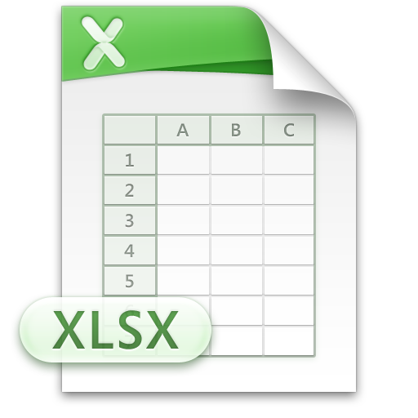

Preparing data for R
comma separate files (.csv) in Data folder
can be created from almost all apps (Excel, LibreOffice, GoogleDocs)
file-> save as…
.csv

Slide 28
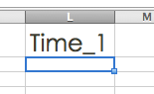
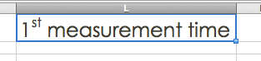
Prep data for R
short informative column headings
starting with a letter
no spaces

Slide 29
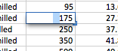
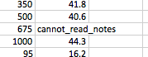
Prep data for R
Column values match their intended use
No text in numeric columns
including spaces
NA (not available) is allowed
Avoid numeric values for data that does not have numeric meaning
Subject, Replicate, Treatment
1,2,3 -> A,B,C or S1,S2,S3 or …

Slide 30
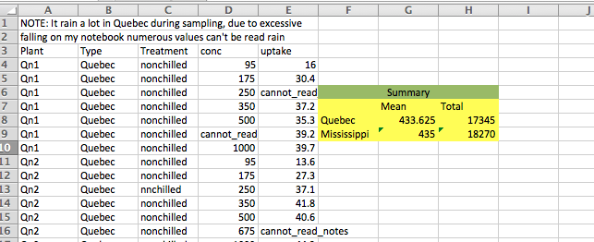
Prep data for R
no notes, additional headings, merged cells

Slide 31
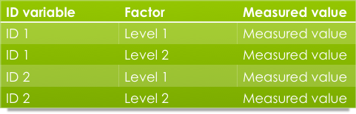
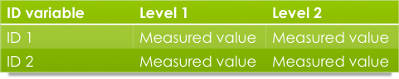
Prep data for R
Prefer long format
Long
Levels are expressed in a column
One measured value per row
eg. really long: XML, JSON (tag:content pairs)
Pros
Plays nice with computers (API, databases, plyr, ggplot2…)
Cons
Does not play nice with humans
Lots of copy pasting and forget eyeballing it!
Wide
Each level of a factor gets a column
Multiple measurements per row
Excel, SPSS…
Pros
Plays nice with humans
No data repetition
“Eyeballable”
Cons
Does not play nice with R

Slide 32
Prep data for R
It is possible to do all your data prep work within R
Saves time for large datasets
keeps original data intact
Can switch between long and wide easily
https://www.zoology.ubc.ca/~schluter/R/data/ is a really helpful page for this

Slide 33
Use your data
Try to load, manipulate, and save your own data* in R
if it doesn’t load properly, try to make the appropriate changes
Remember to clear your workspace first!
When you are finished, try opening your exported data in excel
If you don’t have your own data, work with your neighbour or
“iris_broken.txt”

Slide 35
Harder Challenge
Read in the file "CO2_broken.csv”
This is probably what your data or the data you downloaded looks like
You can do it in R (or not…)
Please give it a try before looking at the script provided
DO: work with your neighbours and have FUN!
HINT: There are 4 errors

Slide 36
Fixing CO2_broken.csv
HINT: There are 4 errors
Some useful functions:
head()
str()
?read.csv – look at some of the options for how to load a .csv
as.numeric()
levels()
gsub()
sappy()
as.data.frame()

Slide 37
Broken data
ERROR 1
Try to read in the data file: iris_broken.csv
It didn’t work because the extension was .txt and not .csv
iris_data<-read.csv("iris_broken.csv")
> iris_data<-read.csv("iris_broken.csv")
Error in file(file, "rt") : cannot open the connection
In addition: Warning message:
In file(file, "rt") :
cannot open file 'iris_broken.csv': No such file or directory
iris_data<-read.csv("iris_broken.txt")

Slide 38
Broken data
ERROR 2
The data appears to be lumped into one line!
head(iris_data)
> head(iris_data)
I.did.my.best.to.create.the.most.annoying.file.to.import.into.R
1 This really looks like the first file I ever imported into R\t\t\t\t\t
2 I since do a way better job of cleaning up my data\t\t\t\t\t
3 But some collaborators will never diverge from their sloppy ways\t\t\t\t\t
4 \tSepal.Length\tSepal.Width\tPetal.Length\tPetal.Width\tSpecies
5 1\t5.1\t3.5\t1.4\t0.2\tsetosa
6 2\t4.9\t3\t1.4\t0.2\tsetosa

Slide 39
Broken data
ERROR 2
Re-import the data, but specify the separation among entries
The sep argument tells R what character separates the values on each line of the file (here; TAB was used)
The first 4 lines are useless
Is anything else strange?
iris_data<-read.csv("iris_broken.txt", sep = “”)
head(iris_data)
str(iris_data)
ERROR 3
iris_data<-read.csv("iris_broken.txt", sep = "", skip = 4)
head(iris_data)
str(iris_data)

Slide 40
Broken data
ERROR 4
Most continuous variables are listed as factors (categorical)
Due to missing values entered as “Forgot_this_value” and “na”
Recall that R only recognizes “NA” (capitalized)
> str(iris_data)
'data.frame': 150 obs. of 5 variables:
$ Sepal.Length : Factor w/ 35 levels "4.3","4.4","4.5",..: 9 7 5 4 8 12 4 ...
$ Sepal.Width : Factor w/ 24 levels "2","2.2","2.3",..: 15 10 12 11 16 ...
$ Petal.Length : Factor w/ 45 levels "1","1.1","1.2",..: 5 5 4 6 5 8 5 6 5 ...
$ Petal.Width : num 0.2 0.2 0.2 0.2 0.2 0.4 0.3 0.2 0.2 0.1 ...
$ Species : Factor w/ 3 levels "setosa","versicolor",..: 1 1 1 1 1 1 ...

Slide 41
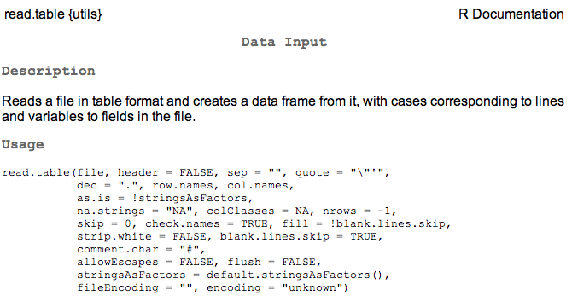
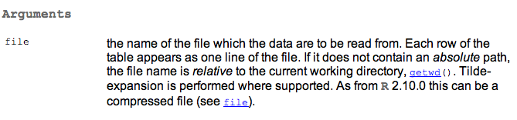
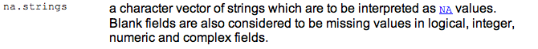
ERROR 4

Slide 42
ERROR 4
The fix!
read.csv("iris_broken.txt",
sep = "",
skip = 4,
na.strings = c("NA","na","Forgot_this_value"))

Slide 43
Broken data
ERROR 5
Ok we’re nearly done!
Some variables still appear as factors
row 23 of Sepal Width was entered as “_3.6” instead of “3.6”
Two new arguments we will need
as.is
as.numeric
class(iris_data$Sepal.Width)
iris_data$Sepal.Width[23]
Tells R to leave the variable alone
Tells R to make the variable numerical

Slide 44
Broken data
ERROR 5
iris_data<-read.csv("iris_broken.txt",
sep="",
skip=4,
na.strings=c("NA", "na","forgot_this_value"),
as.is=c("Sepal.Width", "Petal.Length"))
Now R thinks these variables are only characters
So next we will use as.numeric
Notice the WARNING message because NAs were introduced where non-numeric values were found.
iris_data$Sepal.Width <- as.numeric(iris_data$Sepal.Width)
iris_data$Petal.Length <- as.numeric(iris_data$Petal.Length)

